Slide 1
COA minor project
Presented by :-
Deepak
Mohan
Sai kiran

Slide 2
1) Program that will copy a string STRING_1 into another string STRING_2 using the instruction MOVSB and REP. 2) Program to print Lower Case Letters from A to Z (Simulation of Do-While Loop ). 3)to convert lower case into upper case and vise versa
Programs :

Slide 3
Software requirements
Basic software requirement to develop programs :-
Language – assembly.
Operating system – windows 7 (or) higher .
Editor – dosbox.
Assembler – nasm

Slide 4
Hardware requirements
Basic hardware requirements to develop programs
A laptop or computer
Processor – Intel core i3 or more.
Hard disk – 5GB .
Base memory – 4GB .

Slide 5
Assembly language
A programming language that uses symbolic names to represent operations, registers and memory locations.
Slightly high level language.
Better than machine language.
Assembler translate assembly to machine code.
Compiler translate high-level programs to machine code
Either directly, or
Indirectly via an assembler

Slide 6
continuation
An assembler is a program that converts source code program written in assembly language into object files in machine language.
Popular assemblers have emerged over the years for the Intel family processors. These include.....
TASM(turbo assembler)
NASM(net wide assembler)

Slide 7
DESCRIPTION
In the early days of programming, all programs were written in assembly language. Now, most programs are written in a high-level language such as c++ or C. Programmers still use assembly language when speed is essential or when they need to perform an operation that isn't possible in a high-level language. Machine code instructions are represented by mnemonics
e.g., MOVE, ADD, SUB

Slide 8
TYPES OF OPCODES
Arithmetic ,logical
add, sub, mult
and, or
cmp
Memory load/store
Ld
Complex
mov

Slide 9
ASSEMBLY LANGUAGE INSTUCTIONS
Built from two pieces
Add R1 , R3 ,3
opcode operands
what to do where to get data
With the data and put the results
(ALU operation)

Slide 10
ADVANTAGES AND DISADVANTAGES
ADVANTAGES:
shows how program interfaces with the processer, operating system, and BIOS.
Shows how data is represented and stored in memory and on external devices.
Clarifies how processer accesses and executes instructions and how instructions access and process data.
Clarifies how a program accesses external devices.
DISADVANTAGES:
Since there is more chance for errors debugging is difficult.
It is difficult to understand by the user compare to high level language.

Slide 11
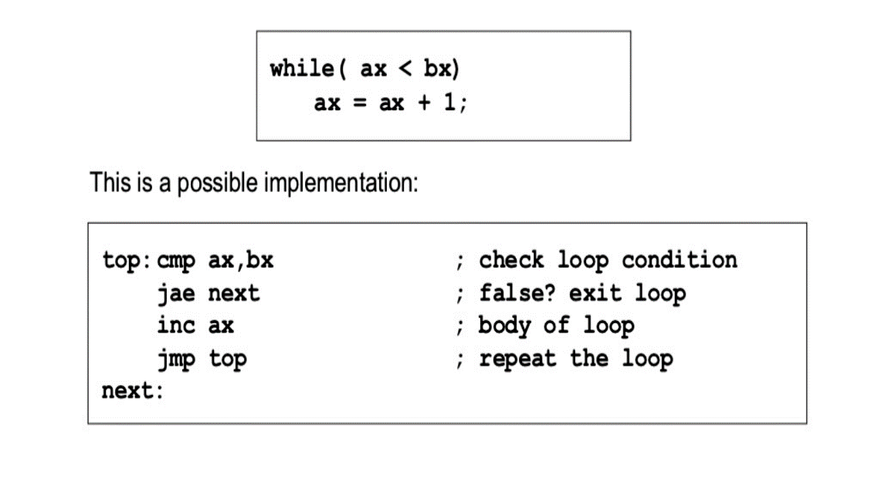
Program to print Lower Case Letters from A to Z (Simulation of While Loop )
This is a program to print lower case letters from a-z in assembly language.
We should print the alphabets using while loop
The while loop is a if statement fallowed by the body of loop fallowed by unconditional jump to top of the loop.
While loop is used to check the condition first if the condition is true then loop will be executed else loop will not be executed.
Here is the example for while loop:-

Slide 12
explanation
cmp :- cmp instruction is used to compare destination operand to source operand.
Note :-non-destructive subtraction of source from destination (destination operand is not changed)
Syntax:- cmp destination,source
jae :- jae is a jump based unsigned comparison , jae is nothing but jump if above or equal
Jae is used when the condition is used to check variable is >= some other variable.
Ex : if a>= b
Jmp :- jmp is used to perform unconditional unconditional jump.
Such an instruction transfers the flow of execution by changing the instruction pointer register.
Syntax:- jmp position
Inc :- it is a key word for incrementing the value.
Syntax:-inc operand

Slide 13
Flow chart of while and do while loops
While loop
Do while loop
condition
Loop statement
false
true
true
Loop statement
condition
false

Slide 14
Program that will copy a string STRING_1 into another string STRING_2 using the instruction MOVSB and REP.
For this program we have read one string using a variable .
movsb moves only a single byte from the source string to the destination
To move the entire string, first initialize cx to the number N of bytes in the source string and execute rep movsb
The rep prefix causes movsb to be executed N times
After each movsb, cx is decremented until it becomes 0

Slide 15
explanation
Mov – to copy or to read a character
Int – to interrupt and give access to micro processor
Cmp – to compare two values
Sub – to substract a value
Add – to add a value
jl – jump if less
Jg – jump if greater
1 – to input a character
2 – to output a character
9 – to output a string

Slide 16
Program to convert lower case into upper case and vise versa.
This is a program to print lower case letters to upper case letters and also upper case letters to lower case letters in assembly language.
In this program, the actual code of conversion of string to upper case (or) lower case is present in main() function. An array of char type is declared which will store the entered string by the user.
Then, for loop is used to convert the string into upper case (or) lower case string and if block is used to check that if characters are in lower case (or) upper case then, convert them in upper case (or) lower case by subtracting 32 from their ASCII value.

Slide 17


